Slide 1


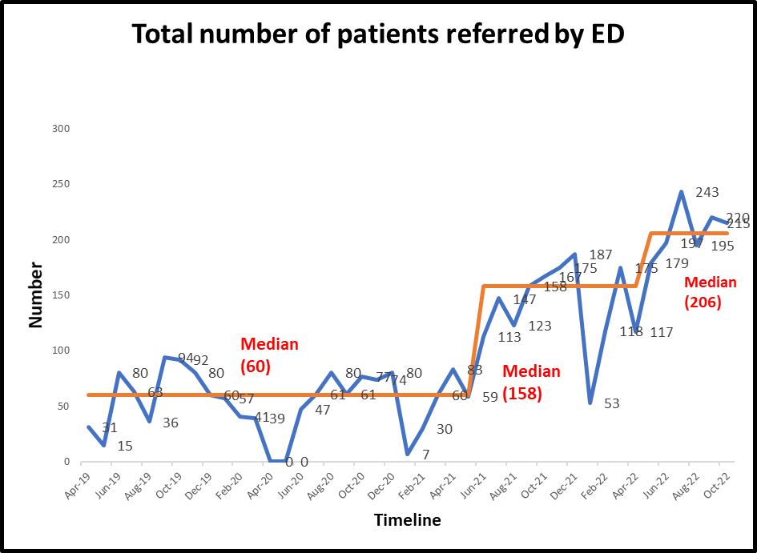
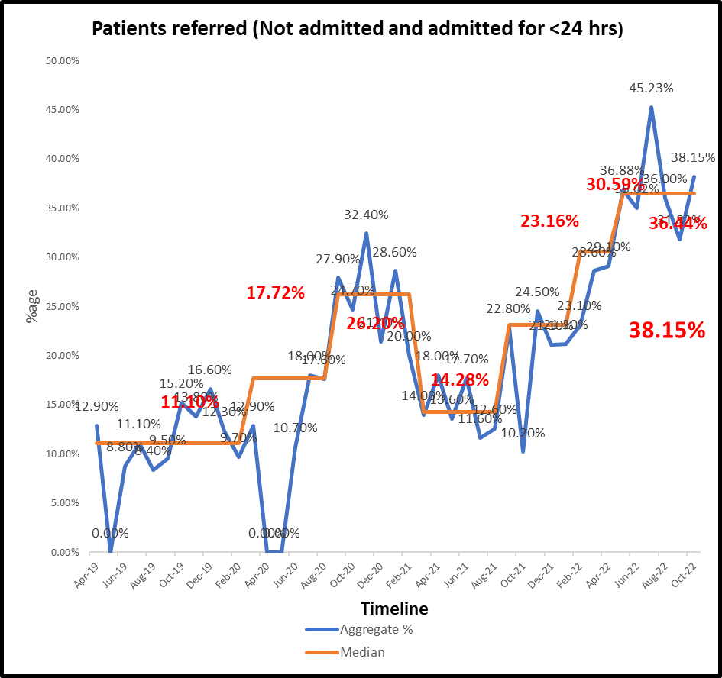
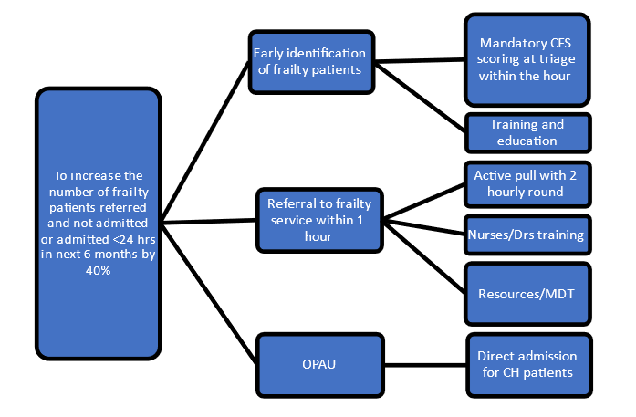
Frailty – Everyone’s Business
BACKGROUND/CONTEXT
At Ashford and St Peter’s NHS trust (ASPH), patients over the age of 75 years constitute approximately 18 -20 % of ED attendances. The 2021 getting it right first time (GIRFT) report showed that older patients are disproportionately admitted into acute hospital beds. This is representative of the situation at ASPH where we found that more than half of those over the age of 75 years are admitted (53%) and this increases to 63% for those over the age of 85. These patients often do not need emergency treatment and their medical needs could be managed outside the acute hospital, in the community, either at or closer to home.
Once admitted, these frail patients run the risk of getting over medicalised, subsequently staying longer in hospital and increased risk of nosocomial harm; deconditioning, further frailty and dependence for health and care needs and increased morbidity and mortality.
MEASURES
The team monitored the total number of frailty patients referred to the service from ED and the number of these not admitted or admitted with a <24hr length of stay, (LOS).
AIM
The team wanted to increase the early identification of frailty patients arriving at ASPH ED and with prompt referral to the frailty team, improve the number of frailty patients referred and not admitted, or admitted for <24hrs by 40% over a 6month period.
THE CHANGES
Existing frailty in reach service was enhanced with the development of dedicated ‘Home First Team’ including members from physiotherapy, occupational therapy, pharmacy technician, adult social services, district and borough teams and the hospital discharge team. Flow coordinators were used to ensure timely discharge of patients. There was also inclusion of junior doctors at the ward round and to complete jobs help facilitate timely discharge or treatment. ‘Criteria to Admit’ was also adopted to ensure that only those requiring acute medical care were admitted. The consultant in charge ensured that the junior team were well supported in the afternoon, for timely discharge of patients. Community services; urgent community response team, locality hubs, SDEC services and virtual wards were used to ensure ongoing care for these patients was provided in or close to their usual place of residence.
DRIVER DIAGRAM:
OUTCOMES
The enhanced frailty services, including the HFT and C2A, resulted in earlier identification of frailty patients within ED and earlier referral to the dedicated team. Patients were then able to be managed without the need for hospital admission, or with a short, <24hr LOS. This approach allowed sustained progress and improvement with benefits to patients and care providers, including significant financial savings.
THE TEAM
Dr Rashid Mahmood, Dr Michael Du, Dr Florence Alemi, Dr Mitveer Gill, Dr Francesca Young and Jay Acharya

